Slide 1


Customer Voice Matters: Big Data Analysis of Amazon Product Reviews
Manasa Rajagopal Madabushi
Pragya Dhungana
Elaine Matter
Vinay Chowdary Muppalla
Harsha Raja Neathala
Rohit Bayya

Slide 2




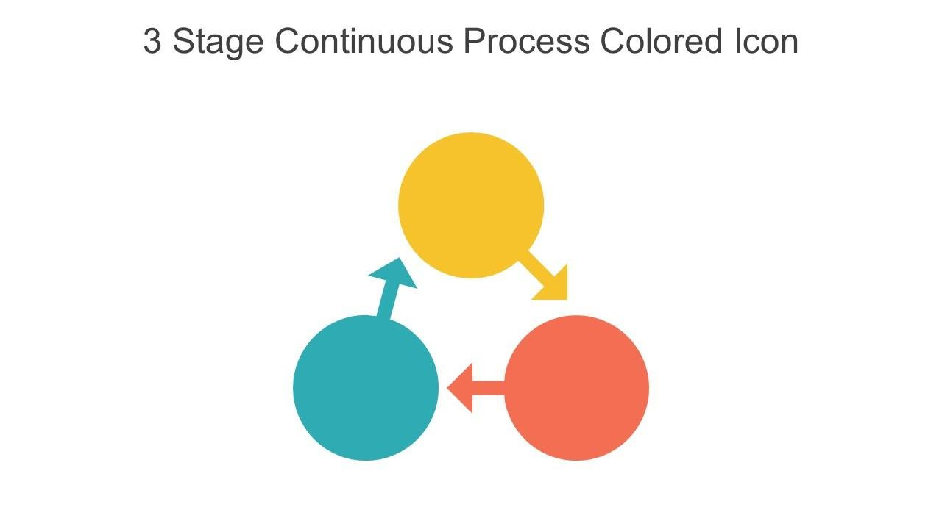





Table of Contents
Introduction
Build vs Buy
Timeline for the project
Problem Statement
Expected value and benefits
About the Data
Stakeholders and Roles
Statistical Analysis
Required Resources
Visualizations
🎯
Research Questions
🧾
Conclusion & Key Takeaways
🌐
🚀
Understanding the Data Landscape
Future Scope

Slide 3

Introduction
Amazon Reviews Dataset: Public dataset from Kaggle/AWS
Qualifies as Big Data:
Volume: Millions of reviews
Variety: Text, ratings, categories
Velocity: Continuously updated
Veracity: User-generated, subject to noise and bias
Amazon product reviews over the span of 18 years
Constructed and processed by Xiang Zhang
Includes customer reviews on products along with their ratings.
specifically designed for text classification tasks

Slide 4
Problem Statement
Amazon gathers millions of daily reviews to inform decision-making.
Manual analysis of feedback is impractical and biased - human prejudice and inconsistency
Automating sentiment analysis provides strategic value.
Focus shifts from classification to quantifying actionable insights.
Supports product managers and executives in decision-making.
Encourages agile and customer-centric business models.

Slide 5

About the Data
Dataset: Amazon Reviews Polarity – labeled positive/negative with headline + detailed text.
Ideal for training sentiment analysis models due to real-world complexity and variation.
Big data challenge: High volume, velocity, and variety.
Cleaned Amazon dataset still contains common user-generated data issues.
Issues include escape characters, formatting inconsistencies, and typos.
Neutral reviews (rating 3) are excluded, introducing label bias.
Redundant or duplicate reviews reduce dataset uniqueness.

Slide 6
Stakeholders and Roles
Researchers and data scientists
Business and AI Developers
Cleaned, labelled data for model training
commercial applications like recommendation engines
Academic Institutions: ex NYU
Amazon
Supports research, ethics and transparency
Leverage sentiment for monitoring, and recommendations.
GDPR and CCPA
Marketing teams
Ensures privacy compliance
Real time sentiment analysis

Slide 7
Required Resources
Platform operators (e.g., Amazon): Adjust search rankings based on sentiment trends, monitor content quality, recommend products more effectively.
Automated systems: Flag underperforming or negatively reviewed products, trigger inspections or rank adjustments.
Marketing teams: Modify campaigns based on customer sentiment trends.
Support teams: Prioritize customer issues using sentiment intensity.
Data scientists: Build analysis pipelines, translate sentiment data into actionable insights for leadership.

Slide 8
Understanding the Data Landscape
Source: Amazon Reviews Polarity Dataset from Kaggle
Structure: Text-based data with review titles, full review body, and sentiment labels (1 = Negative, 2 = Positive)
Nature of Data: Unstructured, user-generated content prone to bias, slang, and noise
Big Data Traits: High volume, high variety, moderate veracity, and fast update frequency
Tech Stack: Processed using Python libraries (pandas, scikit-learn, TF-IDF, WordCloud)

Slide 9
Research Questions
1. How does the sentiment polarity in product reviews impact customer purchasing behavior?
Understanding this helps businesses improve their product offerings and marketing strategies by aligning with customer expectations.
2. Is there a measurable relationship between negative reviews and higher product return rates?
This can help companies proactively identify and fix recurring product issues, reducing return costs and improving satisfaction.
3. How does the length of reviews vary across different product categories, and does it correlate with sentiment strength?
Longer reviews may indicate more passionate sentiment (positive or negative) and can reveal deeper insights about customer experience.
4. Can we accurately classify Amazon reviews into positive and negative categories using machine learning models?
This question addresses the core of our technical implementation—assessing the effectiveness of Logistic Regression and Naive Bayes models.

Slide 10
Build vs Buy Analysis
Made our own sentiment analysis system
Ready-made tool is easy and fast, but often expensive, hard to modify, and not transparent.
Can be Risky esp about fairness, privacy, or using specific language.
Built our own system promotes operations, cost savings, and growth potential.
Fosters a system tailored exactly to the needs.
Boosts team's ability to understand data and encourages responsibilities

Slide 11
Timeline for the Project
Week 6
Week 5
Final documentation, report writing, and presentation
Week 4
Visualizations and interpretation of results
Week 3
Model training and evaluation
Week 2
Week 1
TF-IDF vectorization and initial model building
Exploratory data analysis and early feature engineering
Data Collection, cleaning and exploration

Slide 12
Expected Value and Benefits
Improves customer satisfaction, brand strength, and product quality
Automatically classifies reviews as positive or negative
Saves time by eliminating manual review of feedback
Helps manage large volumes of customer input
Guides design, pricing, and marketing decisions
Identifies features needing improvement or worth promoting
Enables faster responses from customer service teams
Supports quality control and customer experience
Complements NPS and CSAT survey tools for deeper insight
Assists both short-term actions and strategic planning

Slide 13
Statistical Analysis
Cleaning the text data: involved changing all text to lowercase, getting rid of punctuation, and removing common words that don't add much meaning, also known as stopwords.
Converted the review text into numbers: using TF-IDF vectorization. helped find important words by giving them scores based on how often they appear in a review compared to the entire dataset.

Slide 14
Statistical Analysis - Continued
Two models used: Logistic Regression and Multinomial Naive Bayes
Logistic Regression: strong and easy to interpret
Naive Bayes: simple and effective for text classification
Data split: 80% training, 20% testing
Evaluation metrics: accuracy, precision, recall, F1-score, AUC-ROC
Precision = false positive rate; Recall = false negative rate
Confusion matrix used to compare predicted vs. actual outcomes
ROC curves created to visualize model performance at various thresholds
Metrics help assess how well models distinguish different sentiments in reviews

Slide 15
Visualizations
Visualizations helped communicate results to both experts and non-experts
Word Clouds showed most common words in positive vs. negative reviews
Confusion matrix used to show true vs. false predictions
ROC curve illustrated model sensitivity and specificity
AUC (Area Under Curve) summarized overall model effectiveness
Bar chart displayed count of positive vs. negative reviews

Slide 16
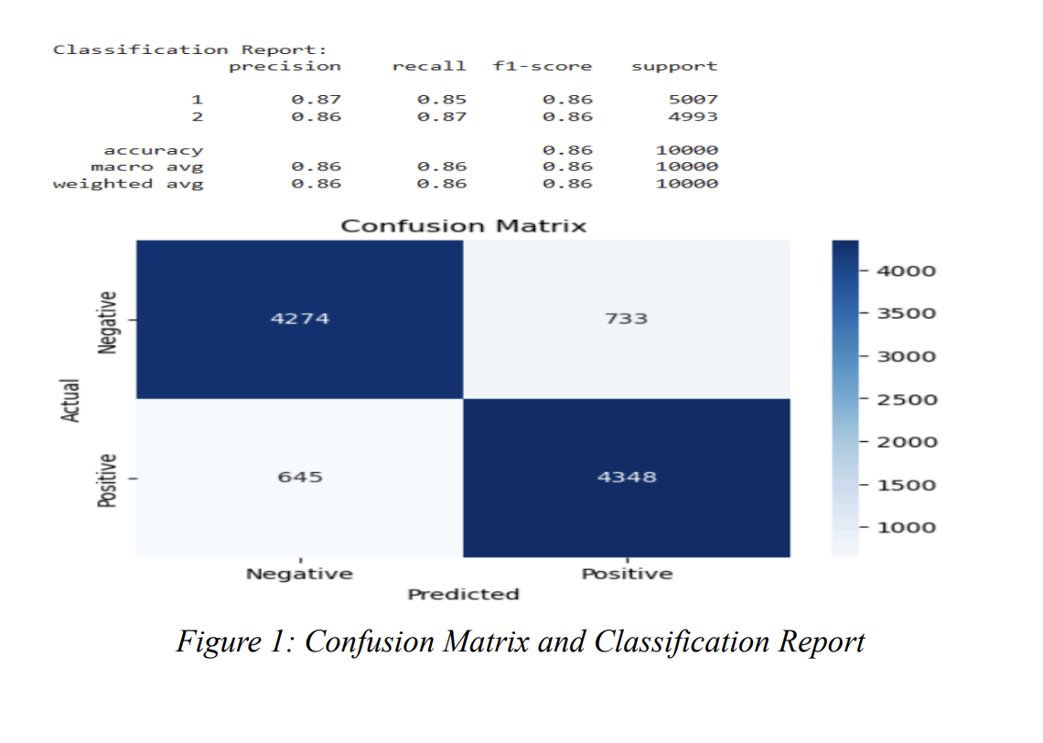
Confusion Matrix and Classification Report

Slide 17
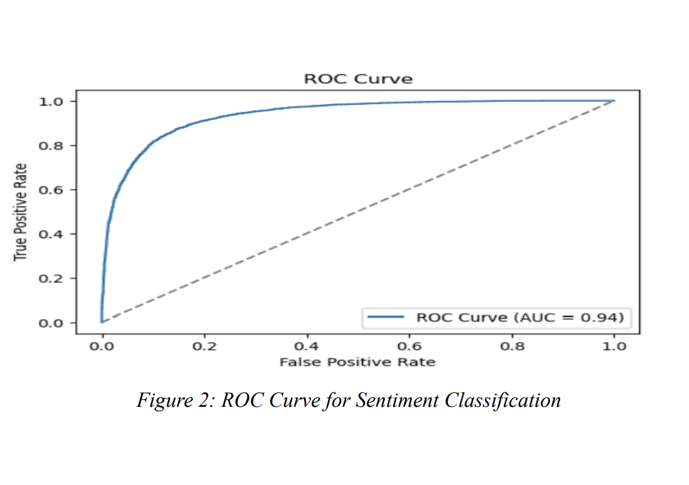
ROC Curve

Slide 18

Word Clouds

Slide 19
Conclusion & Key Takeaways
Conclusion
Our project showed that machine learning can accurately classify Amazon reviews as positive or negative.
Sentiment trends offer real insights into customer experience and product satisfaction.
The results support better product development, marketing, and customer service strategies.
Key Takeaways
Sentiment drives decisions – Negative reviews are often linked to higher return rates.
Logistic Regression performed best – Achieved an AUC of 0.94.
Returned items get more negative reviews – Useful for proactive product improvement.
Real business impact – Results can support recommendations, targeting, and CX optimization.

Slide 20

Future Scope
Incorporate Deep Learning Models Integrate advanced models like BERT, LSTM, or Transformers to capture deeper context and improve sentiment classification accuracy.
Expand to Multilingual Reviews Support sentiment analysis across multiple languages to serve global customer bases and enhance model inclusivity.
Real-Time Sentiment Monitoring Build pipelines for live review analysis to help businesses respond instantly to customer concerns.
Multi-Class Sentiment Labels Move beyond binary classification (positive/negative) to include neutral, mixed, or emotion-based sentiment categories.

Slide 21

Questions

